Slide 1

Swimming Scholarship Enrollment Clustering
Killariben Limbachiya
DS-520
STD ID: 1365974

Slide 2
Background:
Swimming is a key sport for many students looking to secure college scholarships. Scholarship committees often need to evaluate swimming applicants based on factors such as academic performance, swimming performance in different styles, and other relevant attributes. Clustering can help understand different types of student segments, optimize scholarship offerings, and tailor support for specific student groups. This assignment focuses on three clustering techniques—K- Means, DBSCAN, and Hierarchical clustering—to analyze and segment the swimming scholarship applicants.
Objective:
Your role is to cluster swimming scholarship applicants based on their academic and swimming attributes using K-Means, DBSCAN, and Hierarchical clustering techniques. Each clustering method will be applied to explore the dataset and generate insights about potential scholarship recipients Several universities and research institutions have applied clustering techniques to analyze student data, aiming to enhance educational outcomes and tailor support services.

Slide 3
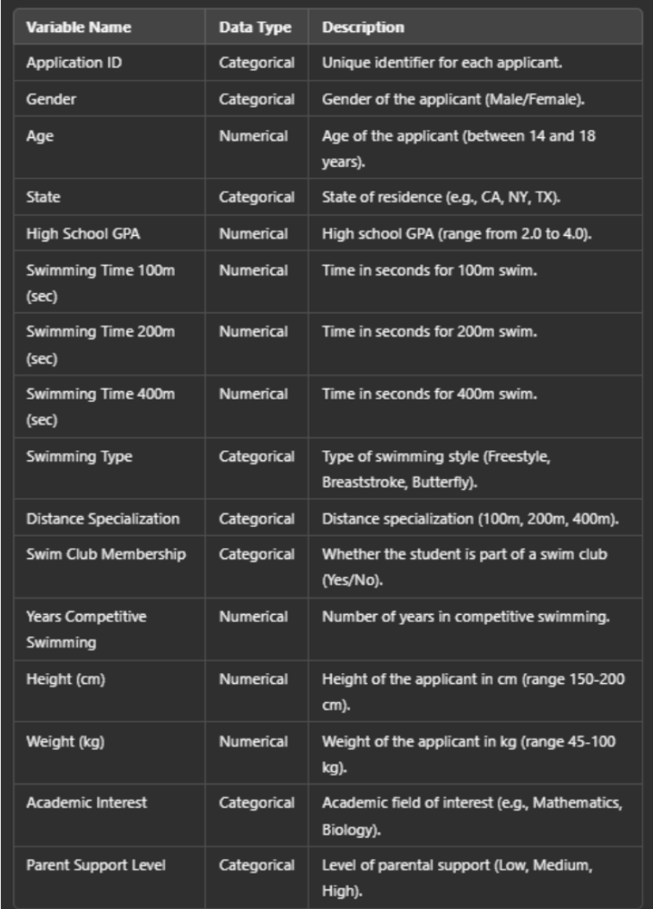
Deep Learning with Python
Data Dictionary

Slide 4
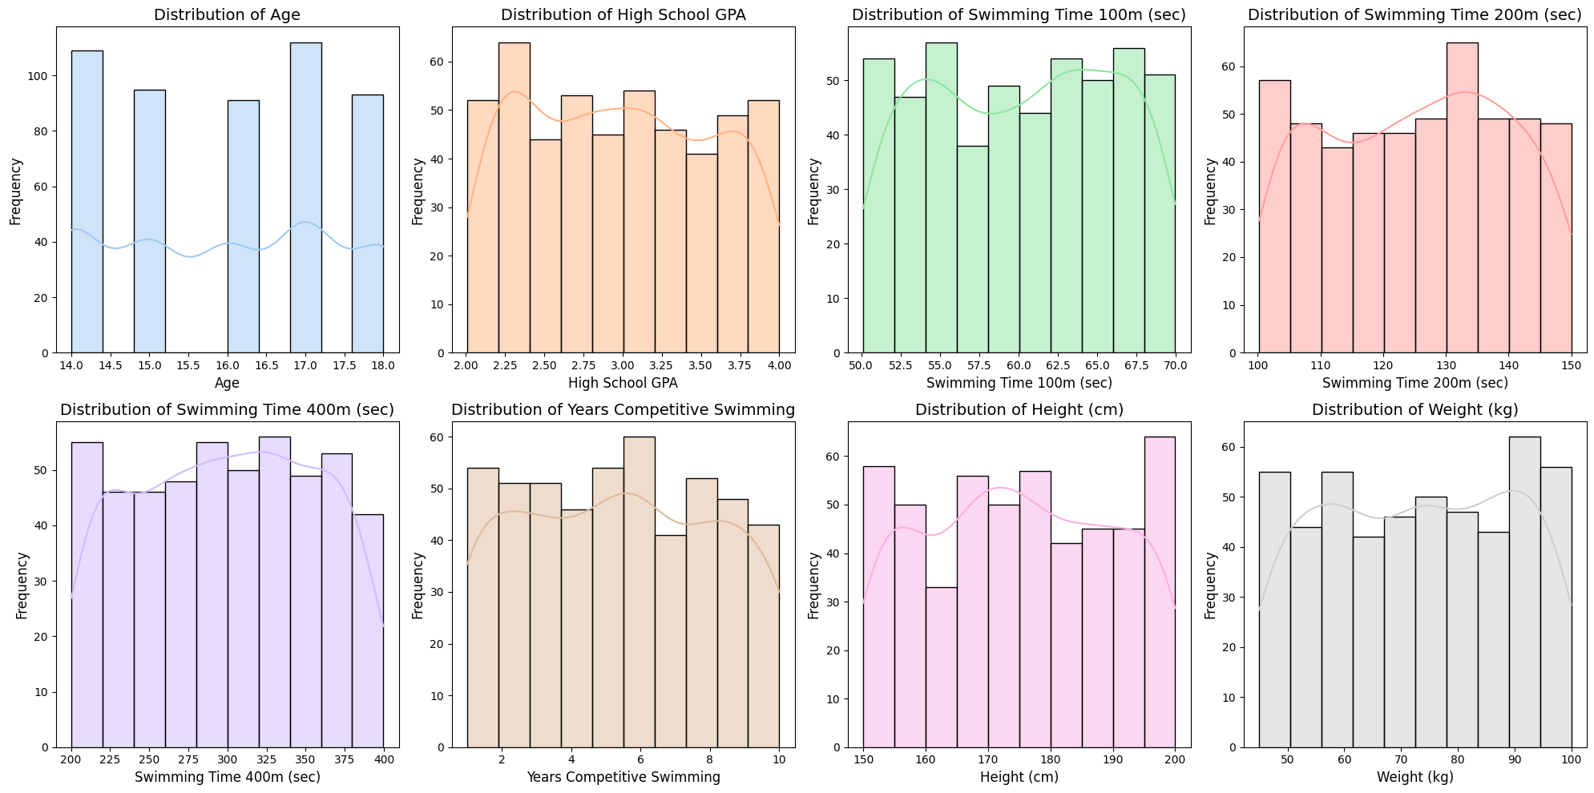
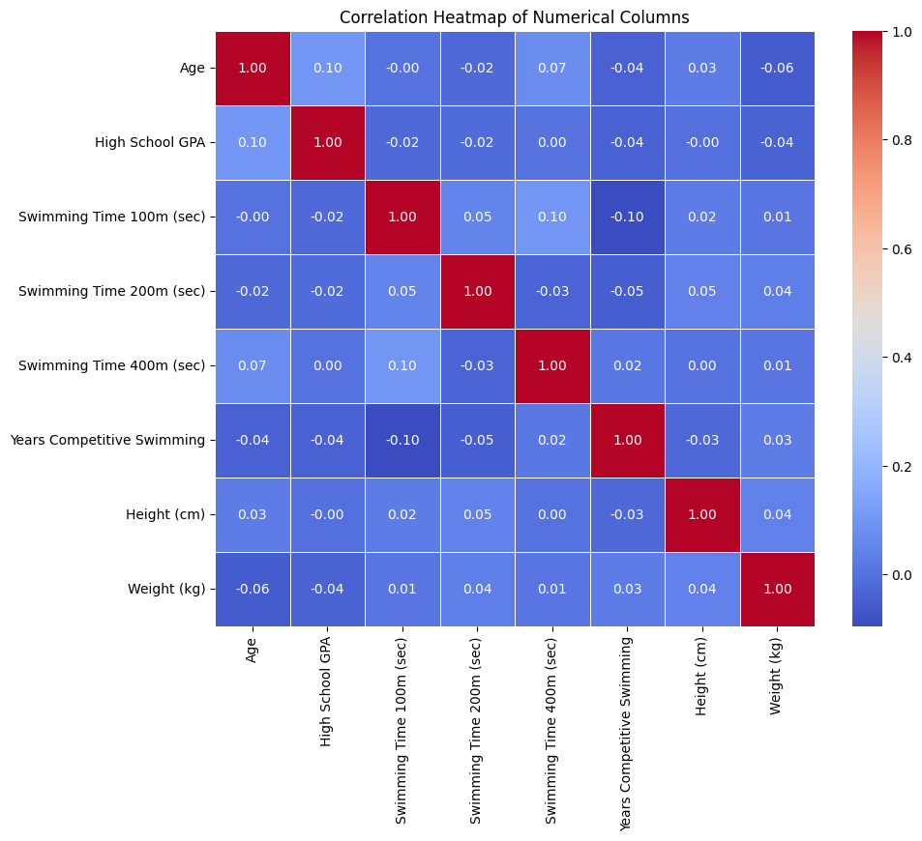
EDA Findings: Highlight patterns and distributions in the data (Numerical)
Age Distribution: The dataset has a balanced age distribution, with significant peaks at 14 and 17 years. This variability reflects a wide range of participant maturity levels.
High school GPA: GPA scores range from 2.5 to 3.5, showing that the majority of students are average academic achievers. A smaller fraction shows either higher or inferior academic achievement.
Swimming Times (100m, 200m, and 400m): Swimming times are evenly distributed throughout events, with some clustering around average performance levels. Variability rises at longer distances (400m), indicating endurance inequalities.
Years of Competitive Swimming: The majority of swimmers had 3-6 years of experience, indicating that a significant amount of the dataset falls into the moderately experienced category.
Height and Weight: The height and weight distributions are consistent with typical athletic ranges, with no severe outliers, making them appropriate for clustering analysis.
Correlation Insights: The heatmap shows weak correlations between numerical variables, with the exception of larger associations between swimming times over different distances, which imply comparable performance trends.
Parental Support and Academic Interest: Strong parental support dominates, which may have an impact on performance. Academic interests are diverse, with mathematics and history being major focus areas.

Slide 5
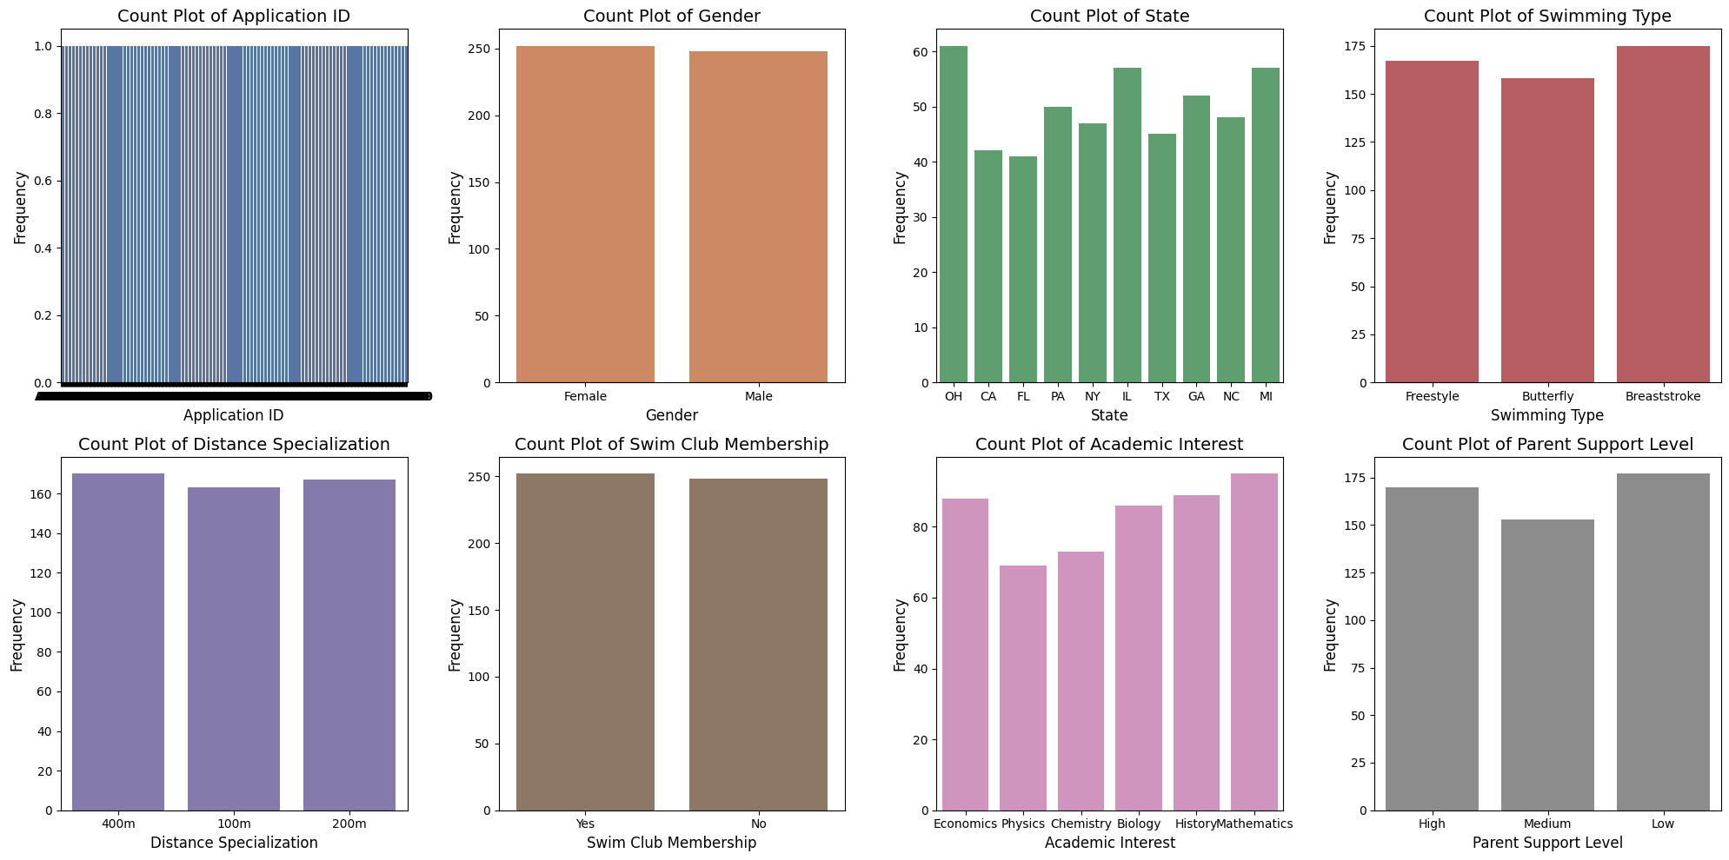
EDA Findings: Highlight patterns, distribution in the data (Categorical)
Gender distribution:
The dataset includes equal numbers of male and female participants, ensuring gender diversity for analysis.
State Representation:
The states with the greatest participation rates are Michigan, New York, and Illinois.
The variation across states reflects regional trends in swimming participation or scholarship applications.
Swimming type:
Freestyle, butterfly, and breaststroke are all represented evenly, with no clear preference among athletes.
This balance enables grouping without bias against any one stroke type.
Distance Specialization:
Specializations in 100m, 200m, and 400m have roughly equal distributions.
Displays consistent attention across swimming distances, indicating widespread involvement.
Swimming Club Membership:
There is an equal distribution of participants with and without swim club memberships.
This feature has the potential to influence performance clusters or insights.
Academic Interest:
Swimming enthusiasts are particularly interested in mathematics and history.
Academic interests add a second layer of division to scholarship or development projects.
Parental Support Levels:
High parental support predominate, followed by medium and low levels, indicating a beneficial external influence on candidates.
The level of support may be related to athletic performance or involvement.

Slide 6
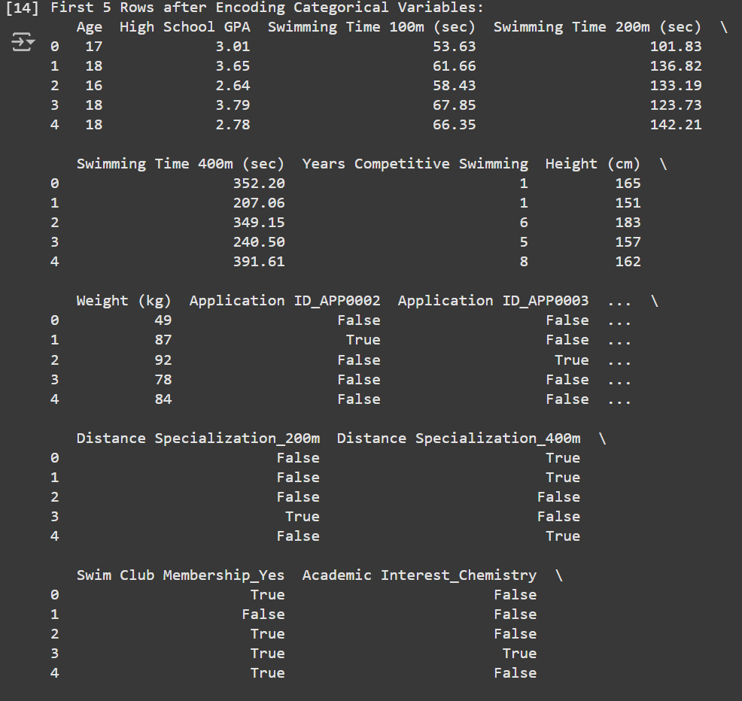
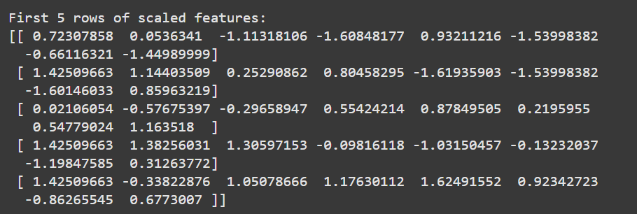
Data Preparation: Explain encoding, scaling, and data engineering techniques used
Deep Learning with Python
Encoding categorical variables:
Categorical attributes like "Distance Specialization," "Swim Club Membership," and "Academic Interest" were translated to numerical binary columns via one-hot encoding.
This enables machine learning models to process these non-numerical features efficiently.
For example, "Swim Club Membership Yes" shows whether the person is a member of a swim club.
Handling Feature Data:
Continuous characteristics such as age, GPA, swimming times (100m, 200m, 400m), years of competitive swimming, height, and weight were kept for scaling.
This step ensures that none of the numerical properties required for clustering are lost.
Feature Scaling:
Standardization was used to normalize features by putting them into a standard normal distribution (mean = 0, SD = 1).
This guarantees that all features contribute equally to the clustering process, preventing features on larger scales (such as height or weight) from dominating the results.
Final Scaled Matrix:
The scaled matrix represents normalized numerical data that is ready to be clustered using techniques such as K-Means, DBSCAN, and hierarchical clustering.
Each row corresponds to a single participant, while each column represents a scaled feature.

Slide 7
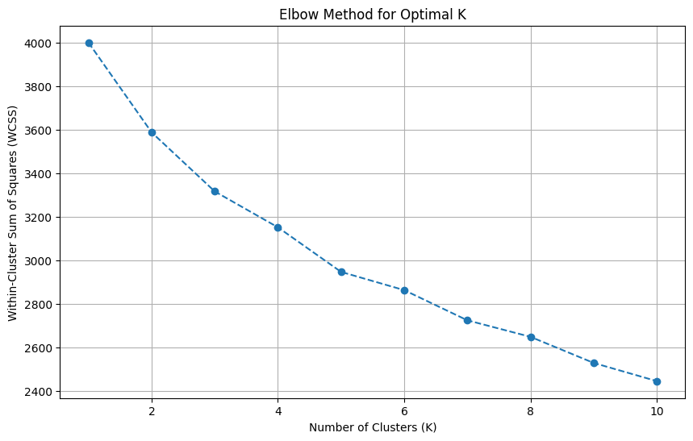
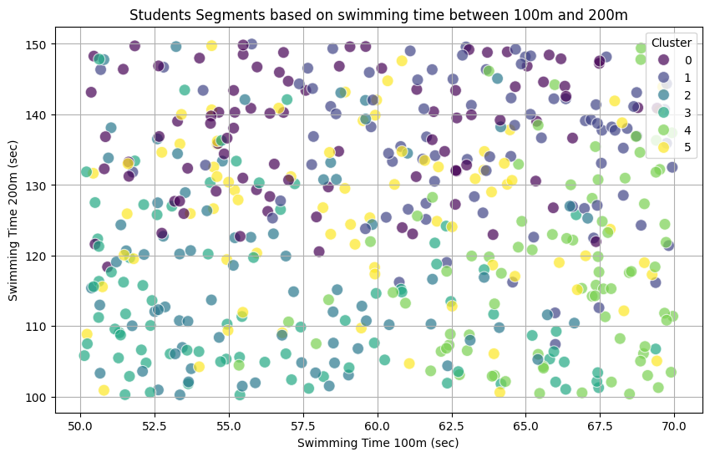
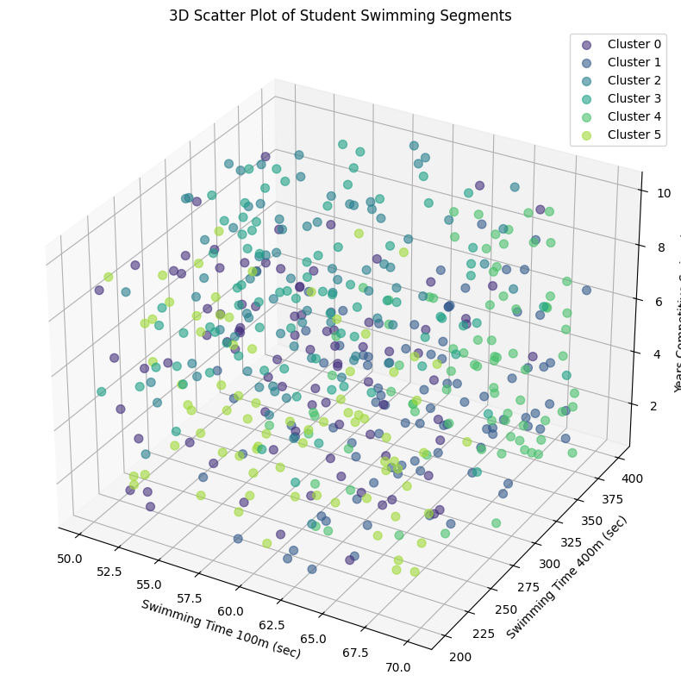
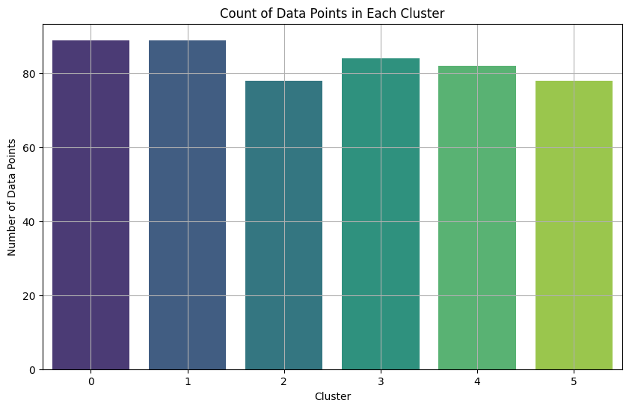
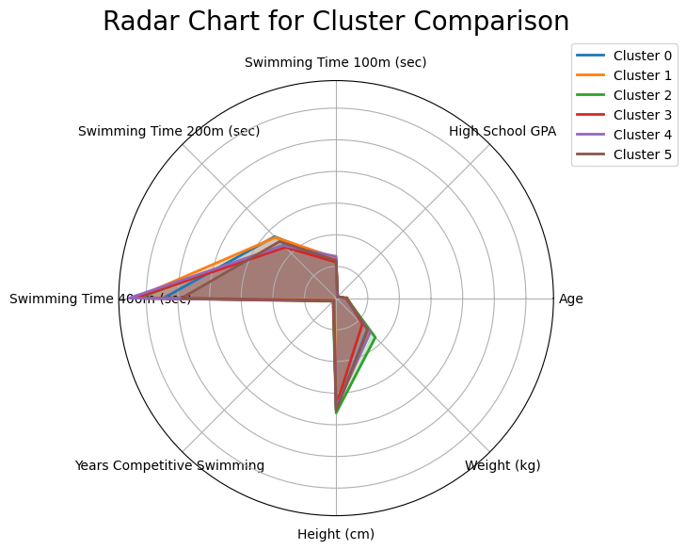
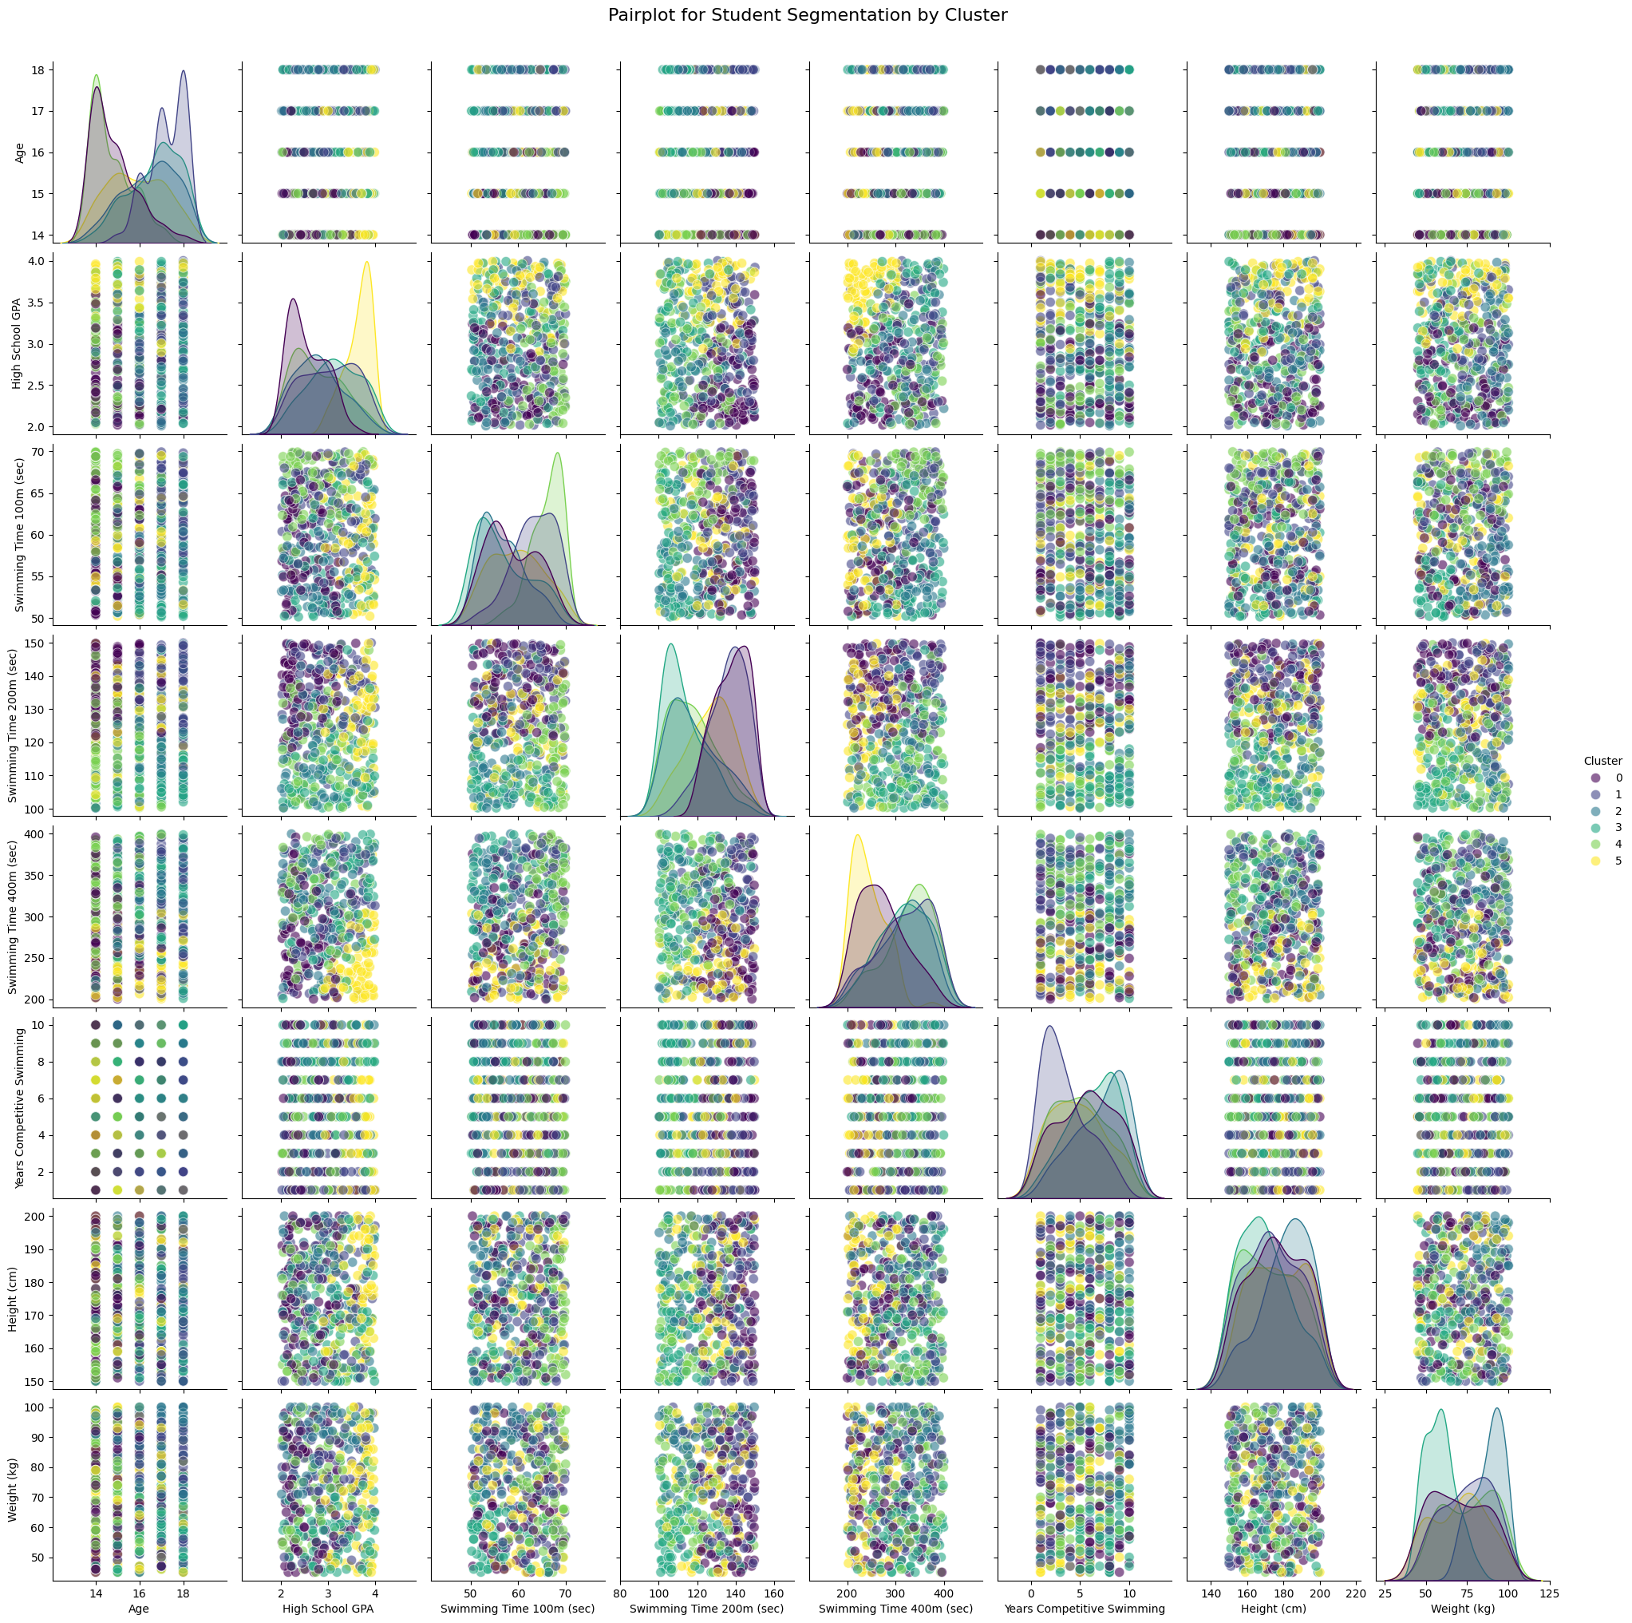
K-Means Clustering Results: Summarize key findings, including cluster graphs and insights
Deep Learning with Python
Optimal number of clusters:
Using the elbow technique, six clusters were identified, with diminishing returns after K=6 for the within-cluster sum of squares (WCSS).
Cluster characteristics:
Clusters were established using a combination of swimming timings (100m, 200m, 400m), GPA, and physical characteristics including height and weight.
Cluster 2 had the best average swimming performance (shortest timings), whereas Cluster 4 stood out for its lower GPA and greater endurance times (400m).
Cluster Graph insights:
2D scatterplots revealed clear cluster separation based on variables such as 100m and 200m swimming timings, which aided in the identification of distinct student segments.
A 3D scatter plot demonstrated the segmentation of key performance and physical variables.
Cluster Sizes:
Each cluster had a properly balanced amount of participants, with all clusters comprising between 80 and 90 data points to ensure no overrepresentation.
Visual tools:
Pair plots and radar charts demonstrated the overlap and differences between clusters, highlighting the key elements that distinguish them.

Slide 8
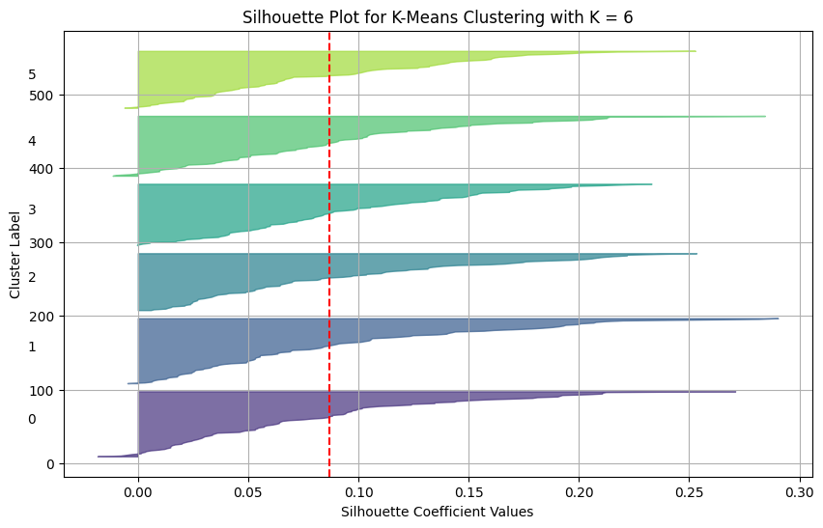
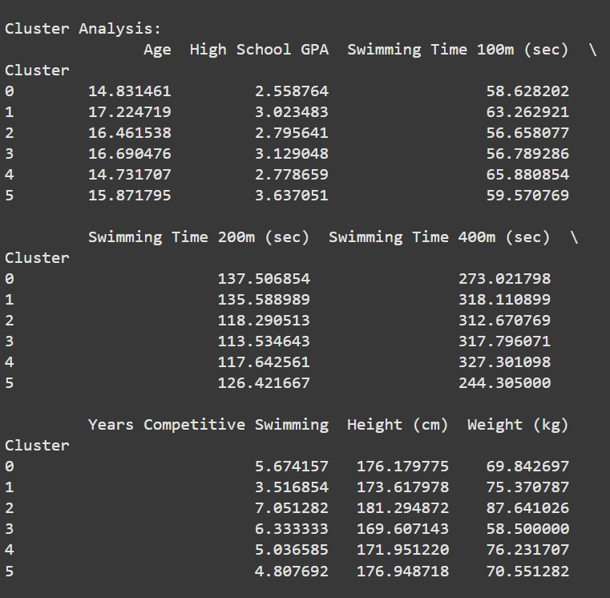
K-Means Performance: Show and explain silhouette scores and feature importance
Silhouette Scores:
The total silhouette score for K=6 was 0.09, indicating moderate clustering performance.
The silhouette plot demonstrated that cluster quality varied, with some clusters (such as Cluster 4) having reduced cohesiveness and separation.
Cluster Interpretability:
Despite moderate silhouette scores, the clusters were interpretable and useful for segmentation, as they correlated with swimming performance, physical attributes, and GPA.
Feature Importance:
Swimming times (100m, 200m, and 400m) emerged as the most important characteristics, allowing strong contrasts within clusters.
Other influencing factors included years of competitive swimming and a high school GPA.
Challenges in performance:
Moderate silhouette scores indicate probable overlaps between clusters, particularly for physical characteristics such as height and weight.
Actionable insights:
Despite limits in cluster cohesiveness, the clustering results provide useful insights on grouping swimmers using a combination of academic, physical, and performance variables.
Deep Learning with Python

Slide 9
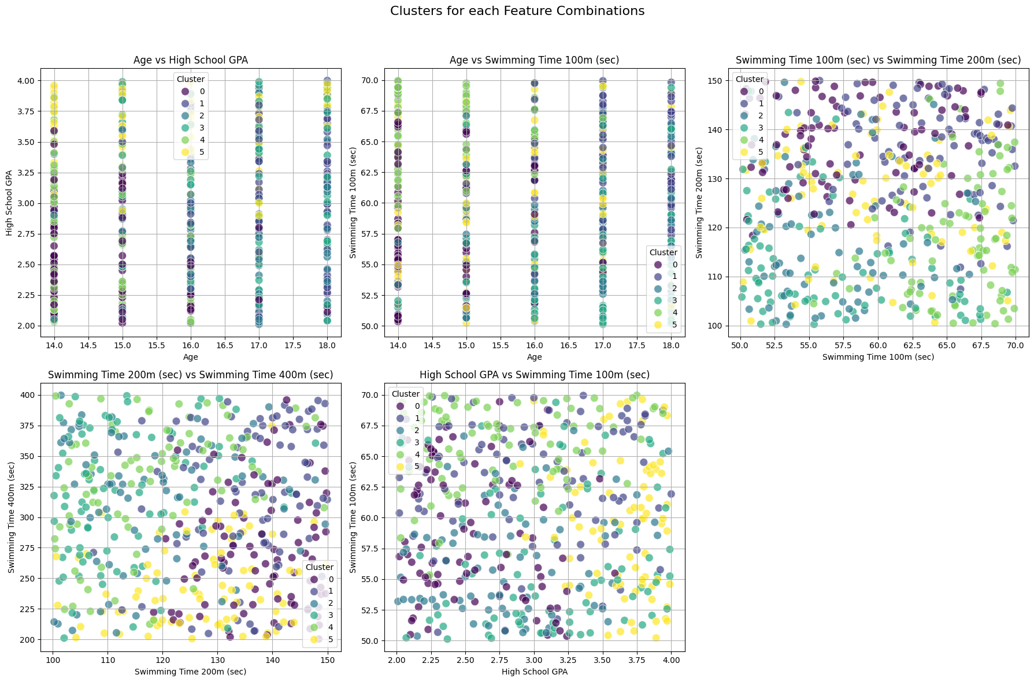
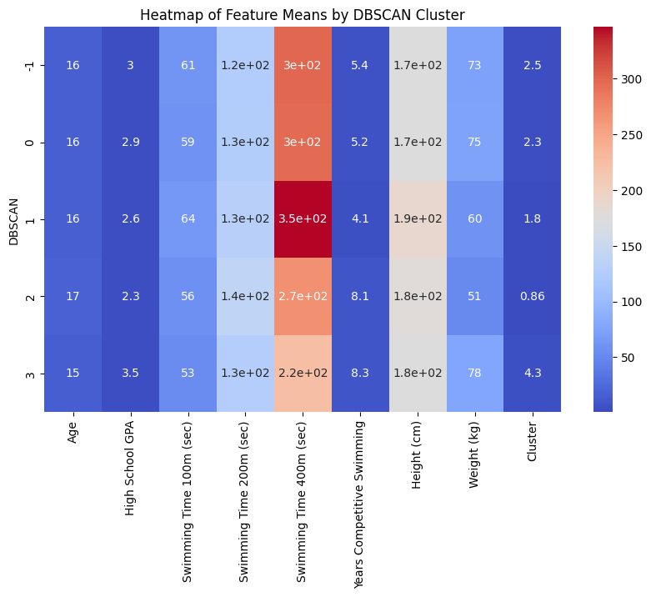
DBSCAN Clustering Summary: Summarize DBSCAN findings and noise points
Deep Learning with Python
Key findings:
DBSCAN discovered four clusters as well as a large number of noise points, especially when the epsilon (eps) was set to 0.5.
Clusters are density-based, and they reflect differences in swimming times (100m, 200m, 400m) and years of competitive swimming.
The heatmap of feature means revealed that Cluster 3 contained participants who performed well in 400m swimming, but Cluster 1 had lower scores in swimming metrics.
Cluster characteristics:
Because the information was sparse in some areas, noise points became conspicuous.
Clusters indicated diverse density patterns, however the data dispersion hindered the capacity to create cohesive groups.
Parameter Sensitivity:
Adjusting eps and min_samples had a considerable impact on clustering, with smaller eps values increasing noise.
Advantages:
DBSCAN identified clusters that relied less on spherical assumptions and better caught irregular data patterns.

Slide 10
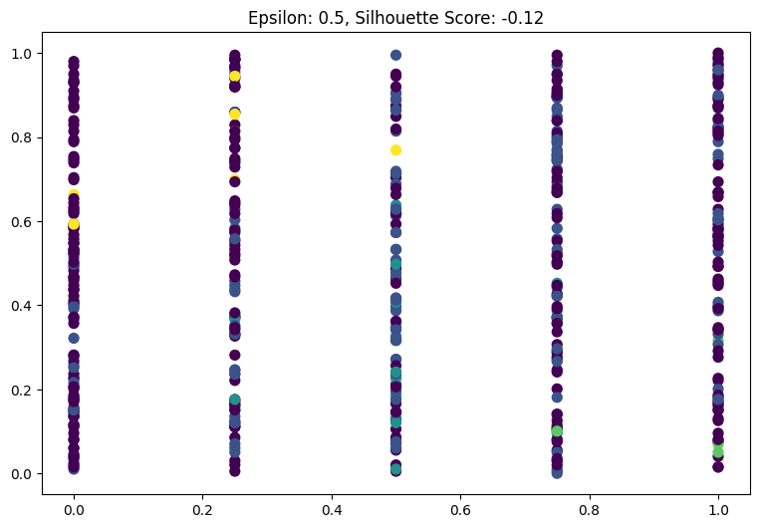
DBSCAN Performance: Show silhouette graphs and discuss clustering quality
Silhouette Scores:
The DBSCAN silhouette score at eps=0.5 was -0.12, suggesting low clustering quality.
Negative silhouette values indicate considerable cluster overlap and poor noise separation.
Graph Analysis:
The silhouette graph revealed that most points were incorrectly assigned, indicating the difficulties in creating meaningful clusters in the dataset.
Clustering Challenges:
The dataset's high dimensionality and low-density regions made it difficult for DBSCAN to generate well-separated clusters.
Noise points made up a considerable fraction, demonstrating the model's sensitivity to parameter adjustment.
Insights:
While DBSCAN provided insights into density-based groupings, its clustering performance on this dataset was unsatisfactory, indicating the necessity for pre-processing techniques such as dimensionality reduction.
Deep Learning with Python

Slide 11
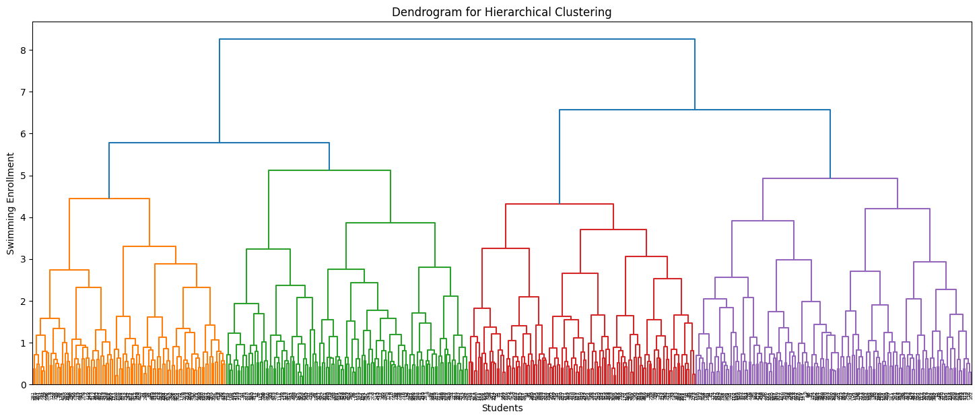
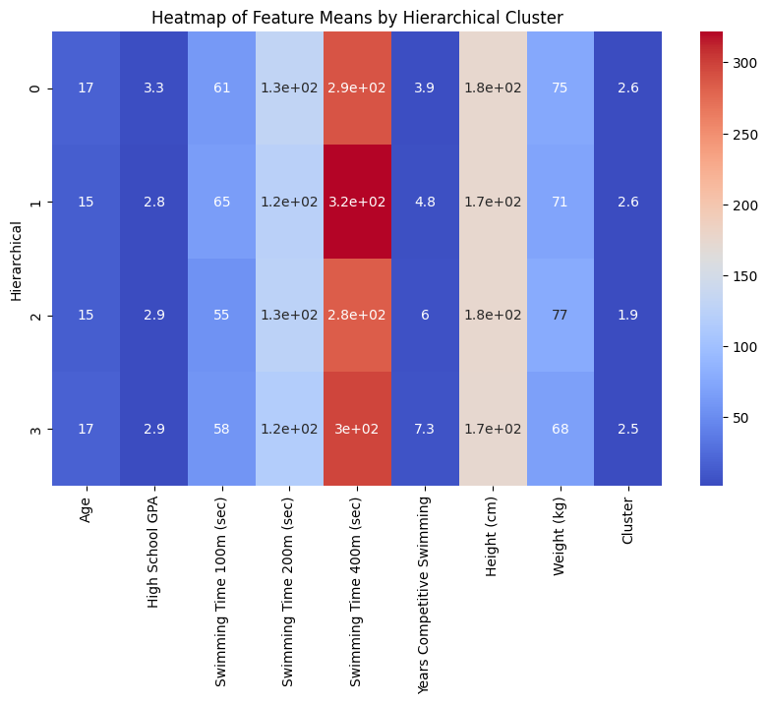
Hierarchical Clustering Summary: Present findings using dendrogram and cluster characteristics
Dendrogram Insights:
The dendrogram showed hierarchical links between the data points, allowing for a visual understanding of cluster development.
At an adequate cut-off height, four primary clusters were clearly separated, indicating unique groupings of participants based on swimming enrollment data.
Cluster characteristics:
Cluster 0 is distinguished by faster swimming timings (400m) and less years of competitive experience, indicating less experienced individuals.
Cluster 1 consisted of participants with intermediate swimming performance but a somewhat lower high school GPA.
Cluster 2 demonstrated superior swimming performance in the 200m and 400m categories, showing a preference for endurance swimmers.
Cluster 3 featured competitors with more years of competitive swimming experience and better performance in 400m events.
Silhouette Score:
The total silhouette score for hierarchical clustering was 0.065, indicating low but adequate cohesion and separation across clusters.
Although not ideal, it demonstrated that the clusters provided useful insights into participant characteristics.
Heatmap of Feature Means:
The heatmap highlighted the average values of critical parameters for each cluster, enabling the identification of distinct cluster profiles.
For example, Cluster 3 had the highest average number of years of competitive swimming experience.
Advantages of Hierarchical Clustering:
Provided a detailed overview of the relationships between data pieces.
There was no predetermined number of clusters, making it suited for exploratory research.
Deep Learning with Python

Slide 12
Model Comparison: Compare K-Means, DBSCAN, and Hierarchical clustering, highlighting strengths and
weaknesses
Clustering Method | Strengths | Weaknesses | Performance | Best Use Case
K-Means | Efficient and scalable for large datasets. | Requires pre-specifying the number of clusters (K). | Silhouette Score: 0.09 (Moderate). | Well-defined, equally sized, and spherical clusters.
 | Works well with normalized, spherical clusters. | Sensitive to outliers and initialization. | Fair separation but overlapping clusters.
 | Provides interpretable cluster centroids. | Struggles with non-spherical and overlapping clusters.
DBSCAN | Captures arbitrary-shaped clusters and handles noise effectively. | Highly sensitive to parameter tuning (eps, min_samples). | Silhouette Score: -0.12 (Poor). | Datasets with distinct dense clusters and well-separated regions.
 | Does not require pre-defining the number of clusters. | Struggles with high-dimensional or sparse datasets. | Significant noise points detected, leading to weak cluster separation.
 | Robust to outliers and density variations. | Limited performance when data lacks dense regions.
Hierarchical | Provides a detailed dendrogram, illustrating hierarchical relationships. | Computationally expensive for large datasets. | Silhouette Score: 0.065 (Weak). | Exploratory analysis to reveal hierarchical relationships in small-to-medium datasets.
 | Does not require pre-specifying the number of clusters. | Sensitive to linkage criterion (e.g., single, complete, average). | Weak separation but useful for identifying relationships between data points.
 | Effective for small-to-medium-sized datasets. | Poor at handling noise and outliers compared to DBSCAN.
Deep Learning with Python

Slide 13
Conclusion: Summarize key insights and provide recommendations for future clustering
studies
Key insights:
K-Means efficiently divided participants into six clusters, however its performance was moderate (silhouette score: 0.09).
DBSCAN emphasized density-based grouping but struggled with noisy and sparse data (silhouette score: -0.12).
Hierarchical clustering yielded useful hierarchical insights but had low cluster cohesion (silhouette score: 0.065).
K-Means was best suited for structured data, DBSCAN for irregular clusters, and Hierarchical for exploratory analyses.
Recommendations:
To improve clustering results, use dimensionality reduction techniques such as PCA.
Optimize parameters (eps for DBSCAN, cluster numbers for K-Means).
Combine approaches (e.g., K-Means + Hierarchical) to improve performance.
Use domain expertise to improve feature selection.
Investigate advanced methods such as Gaussian Mixture Models for complex datasets.
Deep Learning with Python

Slide 14
Thank you

